Slide 1
Natural Language Processing (NLP)
Lecture 8: Language Model Evaluation
Dr. Muhammad Taimoor Khan

Slide 2
N-grams (Review)
For the sentence,
its water is so transparent that _____
Unigram
P(w|its water is so transparent that) = P(w)
Bigram
P(w|its water is so transparent that) = P(w | that)
Trigram
P(w|its water is so transparent that) = P(w | transparent that)
…

Slide 3
Bigram probabilities
P(english|want) = .0011 P(chinese|want) = .0065 P(to|want) = .66 P(eat | to) = .28 P(food | to) = 0 P(want | spend) = 0 P (i | <s>) = .25
Chinese food has more chances of being picked

Slide 4

Estimating bigram probabilities (Demonstration)
The maximum likelihood estimate
$$P\left(wi | wi−1\right)=\frac{count(wi, wi−1)}{count(wi−1)}$$
<s> I am Sam </s> <s> Sam I am </s> <s> I do not like green eggs and beef </s>
$$P\left(I | <s>\right)=\frac{2}{3}=0.67$$
$P\left(<\backslash s> | Sam\right)=\frac{1}{2}=0$.5
P(Sam|<s>)=1/3 = 0.33
P(Sam | am) = ½=0.5
P(am| I) = 2/3 = 0.66
P(do | I) = 1/3 = 0.33

Slide 5
Bigram estimates for a sentence
P(<s> I want english food </s>) = P(I|<s>) × P(want|I) × P(english|want) × P(food|english) × P(</s>|food) = .000031
Sentences may be rare but their phrases are frequent

Slide 6
Google N-gram release: 2006
Google shared its enormous dataset having 1,024,908,267,229 words of running text and are publishing the counts of all 1,176,470,663 five-word sequences that appear at least 40 times. There are 13,588,391 unique words, after discarding words that appear less than 200 times.
4-grams counts
serve as the incoming 92 serve as the incubator 99 serve as the independent 794 serve as the index 223 serve as the indication 72 serve as the indicator 120 serve as the indicators 45 serve as the indispensable 111 serve as the indispensible 40 serve as the individual 234

Slide 7
Evaluating language models
Does our language model prefer good sentences to bad ones?
Assign higher probability to “real” or “frequently observed” sentences. Than “ungrammatical” or “rarely observed” sentences?
We train parameters of our model on a training set.
We test the model’s performance on data we haven’t seen.
A test set is an unseen dataset that is different from our training set, totally unused.
An evaluation metric tells us how well our model does on the test set.

Slide 8
Comparing models A and B
Put each model in a task
For example, spelling corrector, speech recognizer …
Run the task, get an accuracy for A and for B
How many misspelled words corrected properly
How many words translated correctly
Compare accuracy for A and B

Slide 9
Evaluation Approaches
Extrinsic
Intrinsic
Human Evaluation (Domain experts manually verify results)
Also called Gold Standard

Slide 10
Extrinsic evaluation
Evaluating the accuracy of the model with respect to an external resource (usually labeled data)
Difficult for N-gram models
Time consuming
Expensive to consult experts
Laborious to label data

Slide 11
Intrinsic Evaluation
Intrinsic evaluation is usually carried out:
Perplexity
Bad approximation
Unless the test data looks just like the training data
So generally, only useful in pilot experiments
But is helpful to think about

Slide 12
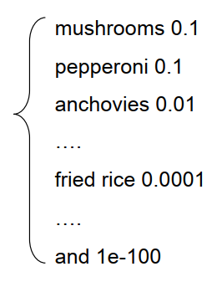
Intuition of Perplexity
The Shannon Game:
How well can we predict the next word?
I always order pizza with cheese and ____
The 33rd President of the US was ____
I saw a ____
Unigrams are terrible at this game. (Why?)
A better model would be the one which assigns a higher probability to the word that actually occurs

Slide 13

Perplexity
The best language model is one that best predicts an unseen test set
$PP\left(W\right)={P(w_{1},w_{2},…,w_{N})}^{−1/N}$
Gives better prediction P(sentence) $=\sqrt[N]{\frac{1}{P(w_{1},w_{2},…,w_{N})}}$
Lower perplexity => Better model

Slide 14
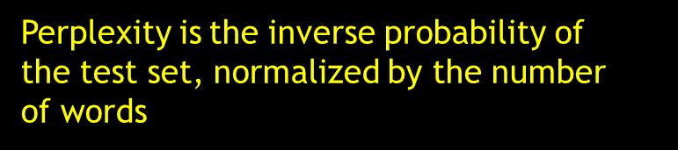

Chain rule $PP\left(W\right)=\sqrt[N]{\prod_{i=1}^{N}{\frac{1}{P\left(w_{i}\right|w_{i−1},w_{i−2,…,w_{1}})}}}$
For bigrams $PP\left(W\right)=\sqrt[N]{\prod_{i=1}^{N}{\frac{1}{P\left(w_{i}\right|w_{i−1})}}}$
Perplexity is the inverse probability of the test set, normalized by the number of words

Slide 15
The Shannon Game intuition for perplexity
How hard is the task of recognizing digits ‘0,1,2,3,4,5,6,7,8,9’
Perplexity 10
How hard is recognizing (30,000) names at Microsoft
Perplexity = 30,000
Perplexity is weighted equivalent branching factor

Slide 16


Perplexity as branching factor
Let’s suppose a sentence consisting of random digits
What is the perplexity of this sentence according to a model that assign P=1/10 to each digit?
For a Unigram Model
$$PP\left(W\right)={P(w_{1},w_{2},…w_{N})}^{−1/N}$$
$$={P({\frac{1}{10}}^{N})}^{1/N}$$
$$=10$$
Coin Flip

Slide 17
Lower Perplexity = better model
Training 38 million words, test 1.5 million words
N-gram order | Unigram | Bigram | Trigram
Perplexity | 962 | 170 | 109

